Slide 1
Lexical data
Studienamiddag werkgroep Digital Humanities
Katrien Depuydt, Jesse de Does
katrien.depuydt@ivdnt.org
jesse.dedoes@ivdnt.org

Slide 2
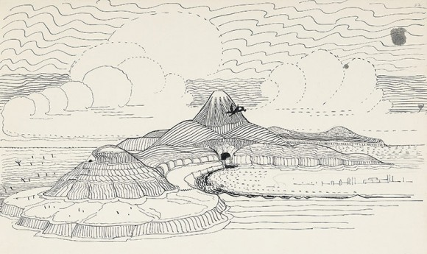
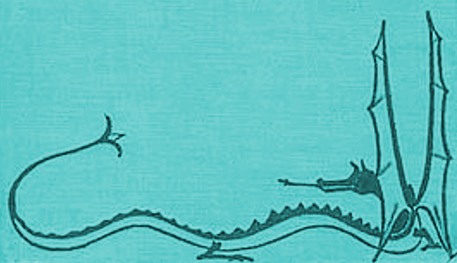
The Gathering of the Clouds. Lexical resources & Linked Open Data

Slide 3
Intro INL lexica
Modern lexicon
180.000+lemmata with paradigm and hyphenation
Historical/diachronic lexica (interlinked where possible)
Historical dictionary portal (“GTB”)
GiGaNT
lemmata, word forms and part of speech from the historical dictionaries
DiaMaNT (in statu nascendi)
Diachronic semantic lexicon

Slide 4
Modern lexicon
Full paradigm and hyphenation information for 180000+ lemmata
Continuous update with new words
Published in lexicon service and (partly) in woordenlijst.org

Slide 5
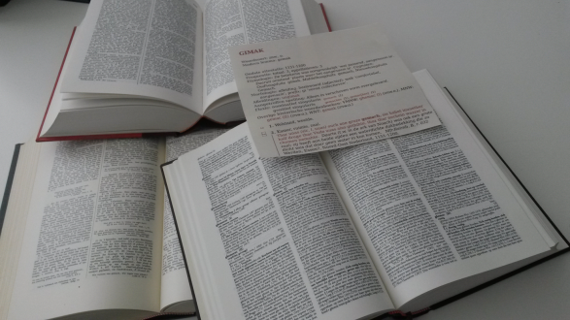
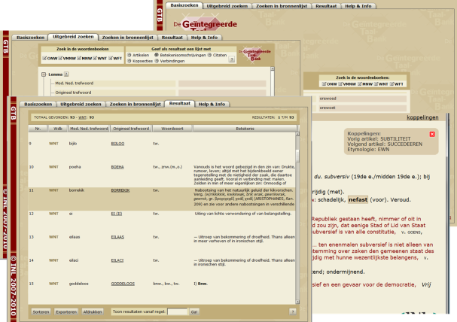
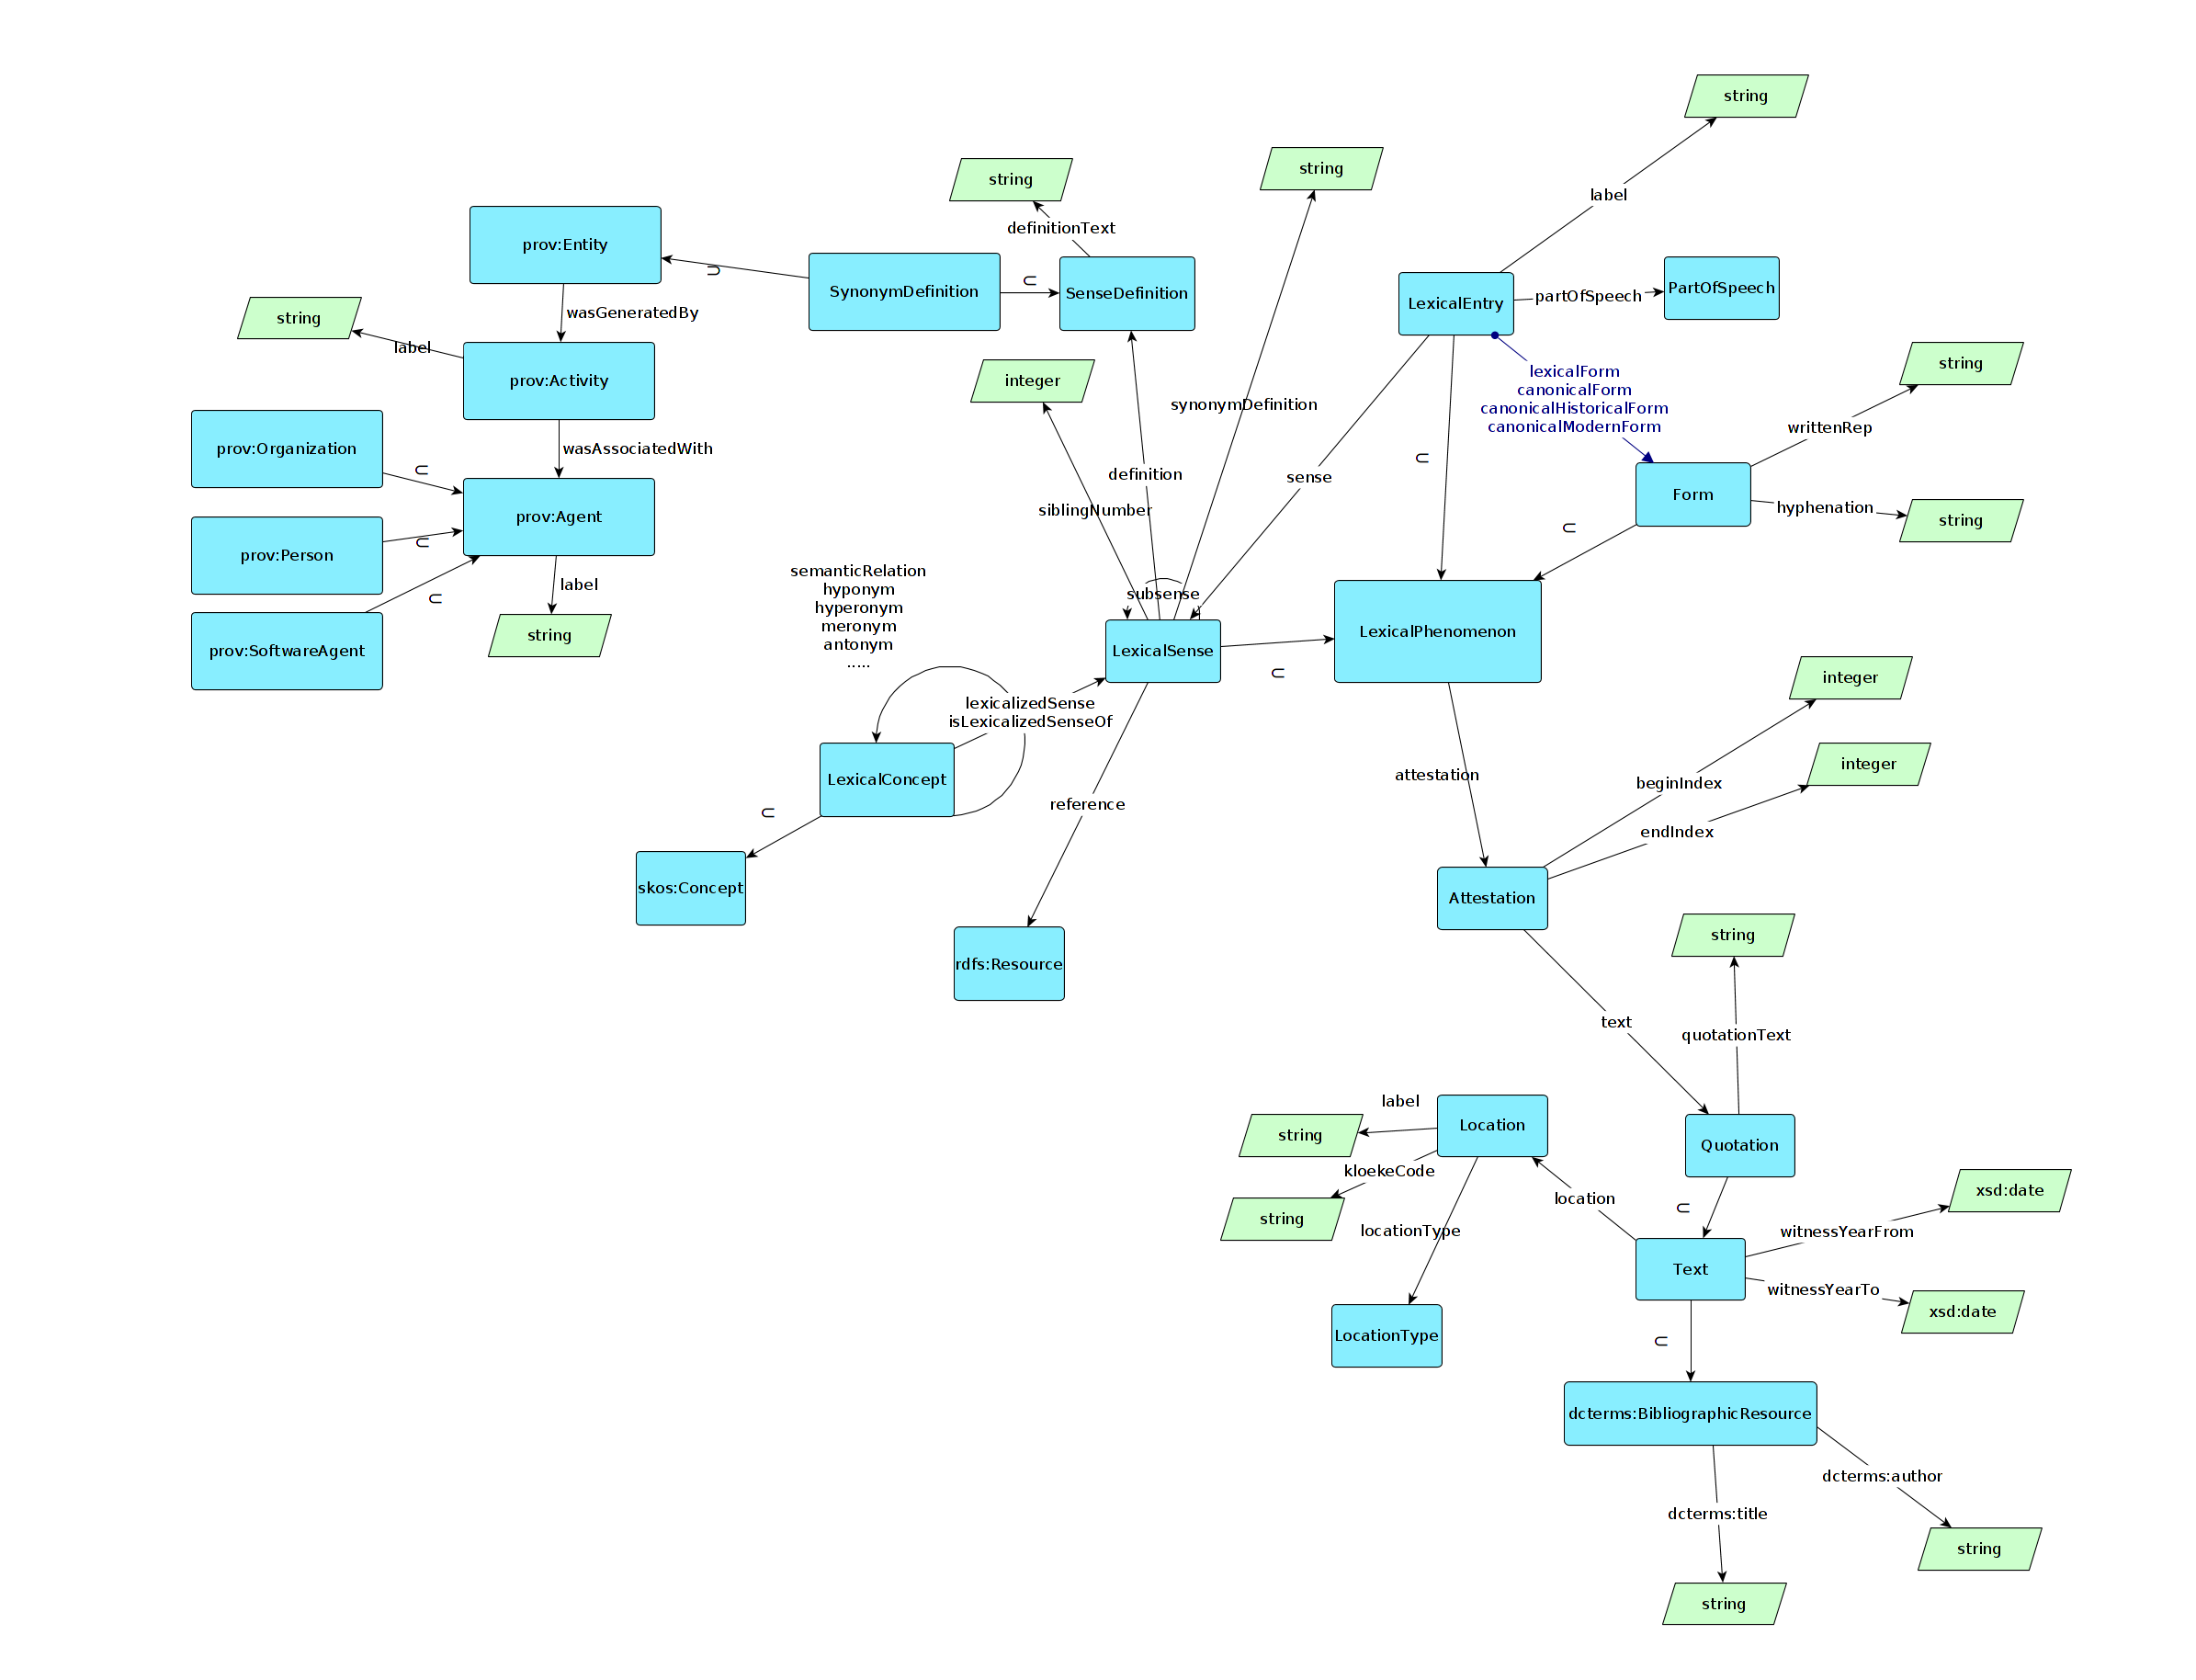
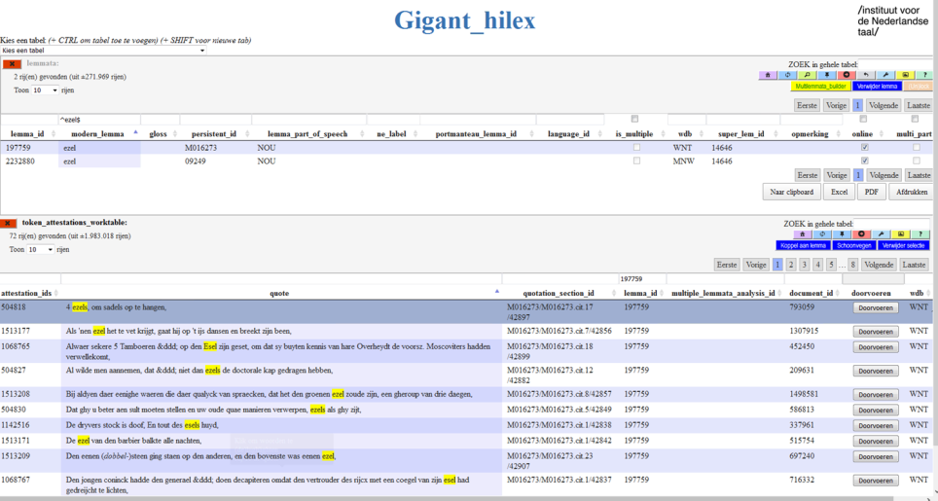
Historical lexica
1
gtb.inl.nl
4
2
3
DiaMaNT
GiGaNT
Notes:
Traditional dictionaries have a lot more potential than functioning as a place to look up meaning of a text.
A first step was: historical dictionary portal with extensie querying possibilities which allow the user to query the dictionary also as a corpus eg.
A second step, is building on top of this a computational lexicon (GiGaNT) project
A final step is - DiaMaNT a diachronic semantic lexicon of Dutch.
All components: reference to the dictionary ground material, the information on formal variation and the semantic information will be integrated in one resource.

Slide 6
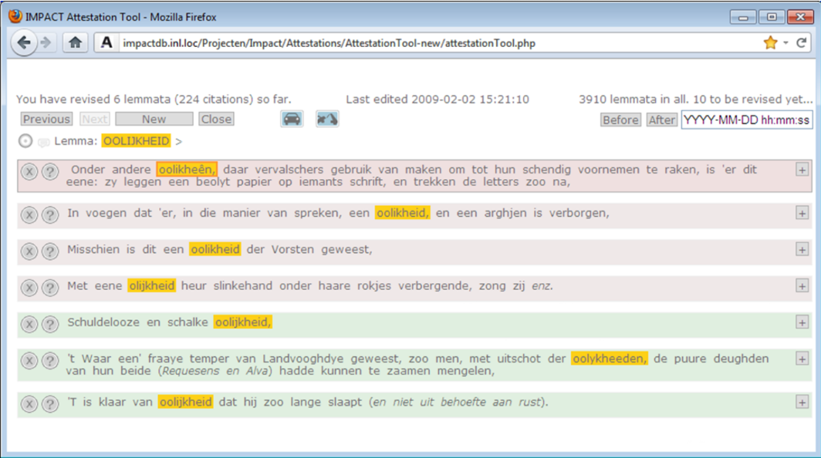
GiGaNT: historical morphosyntactic lexicon

Slide 7
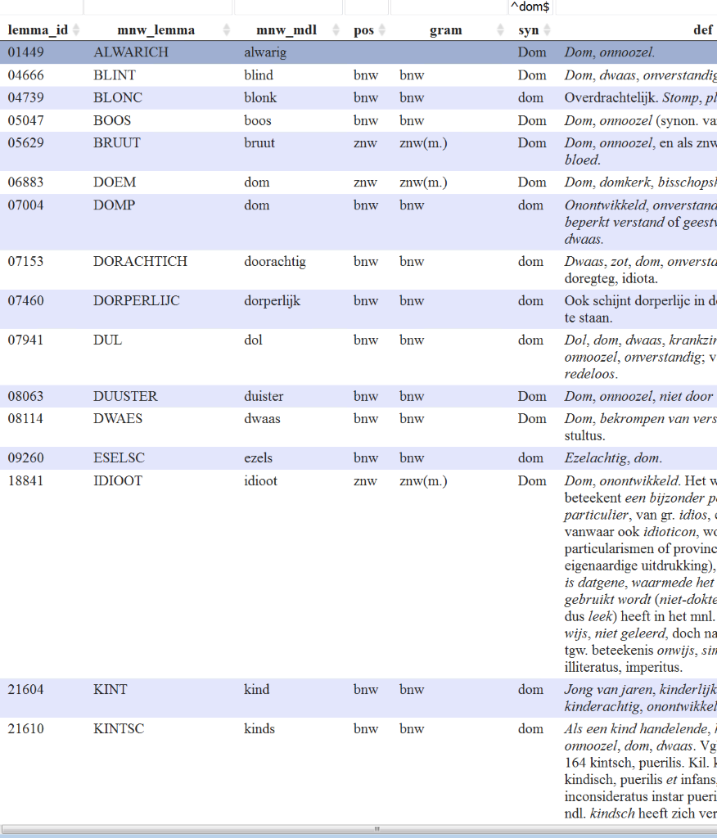
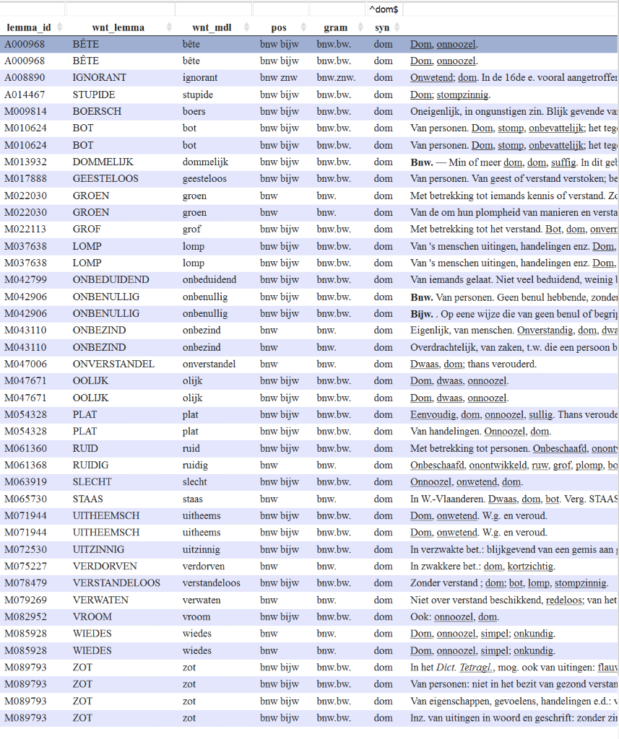
DiaMaNT: diachronic semantic lexicon

Slide 8
Ways of using using the lexica
Just manual lookup
Use in computational tools (Nederlab tagging, INL-labs, …)
Use in search scenario’s
Simple query expansion
More general: “chaining search”

Slide 9
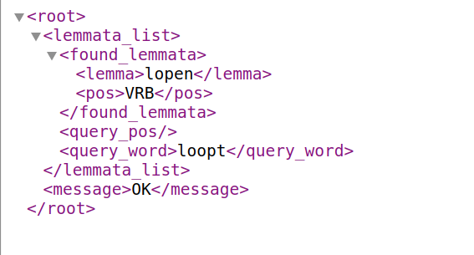
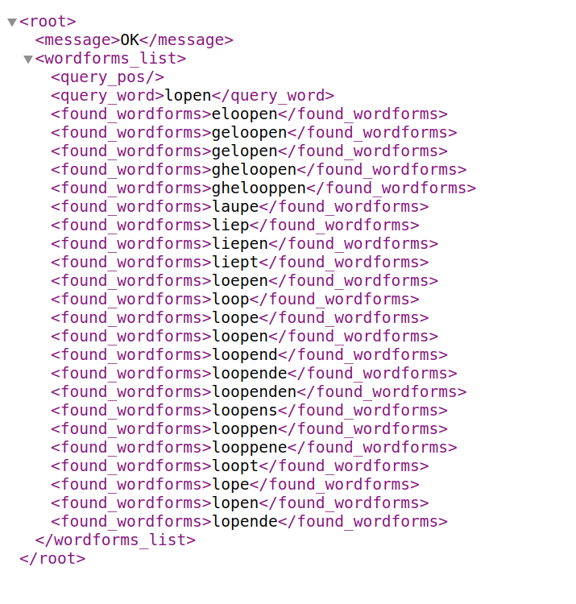
Lexicon service
From wordform to lemma:
http://sk.taalbanknederlands.inl.nl/LexiconService/lexicon/get_lemma?database=lexicon_service_db&wordform=loopt
From lemma to wordforms:
http://sk.taalbanknederlands.inl.nl/LexiconService/lexicon/get_wordforms?database=lexicon_service_db&lemma=lopen
Notes:
modern lexicon:
http://sk.taalbanknederlands.inl.nl/LexiconService/lexicon/get_lemma?database=molex&wordform=liep

Slide 10
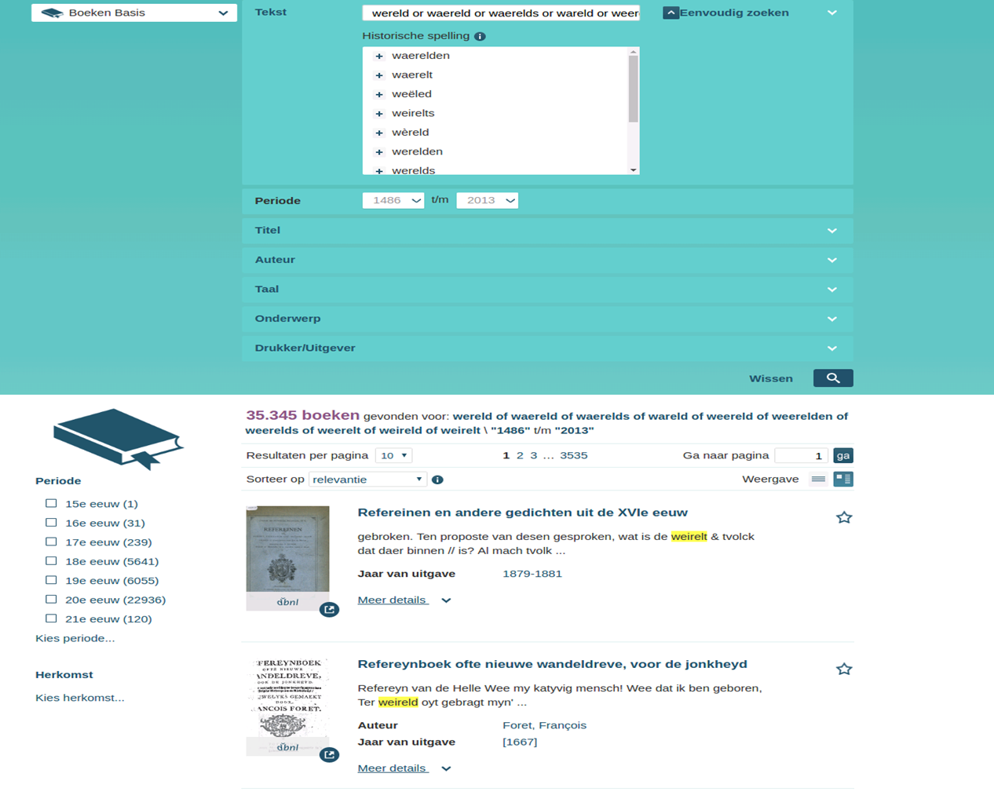
Lexicon service (implementation example)

Slide 11
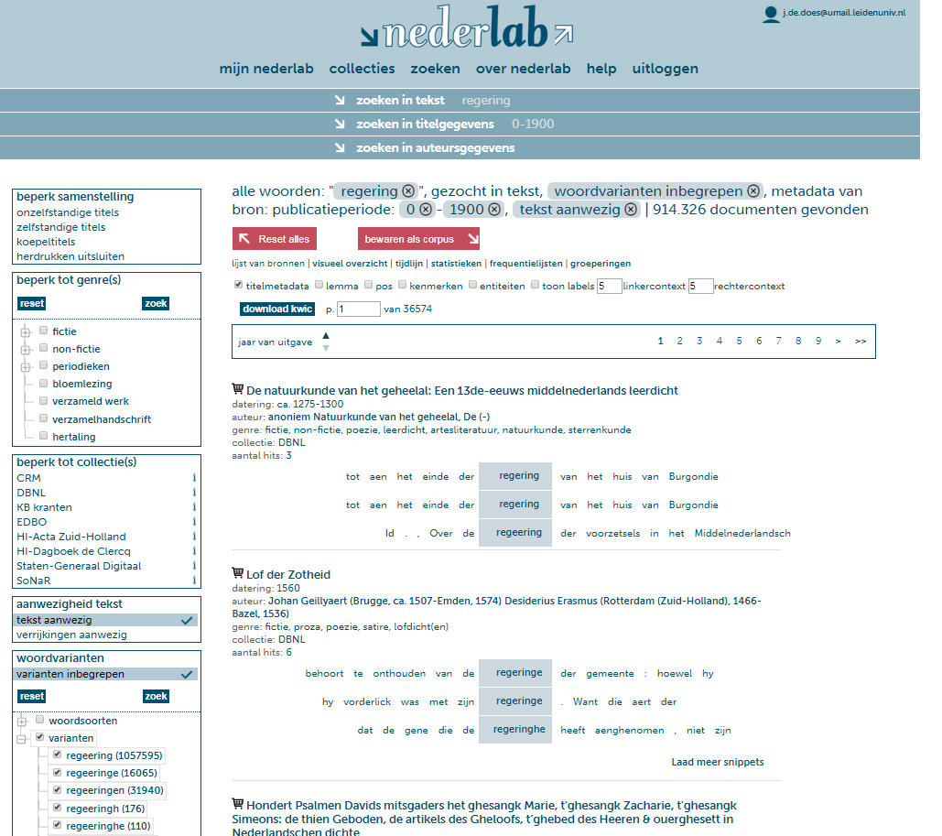
Notes:
Also http://uudigitalhumanitieslab.github.io/HistoLexic/

Slide 12
Code sample
import scala.xml._
object LexiconService
{
case class LexiconService(serviceURL: String, database: String)
{
def getWordforms(lemma: String):List[String] =
{
(XML.load(s"$serviceURL/get_wordforms?database=$database&lemma="
+ lemma.toLowerCase)
\\ "found_wordforms").toList.map(_.text.toLowerCase).filter(_.matches("^(\\p{L})*$"))
}
def getLemmata(wordform: String):List[(String,String)] =
{
(XML.load(s"$serviceURL/get_lemma?database=$database&wordform=" + wordform.toLowerCase)
\\ "found_lemmata").toList.map(e => ((e \ "lemma").text, (e \ "pos").text))
}
}
val serviceURL = "http://sk.taalbanknederlands.inl.nl/LexiconService/lexicon"
val database = "lexicon_service_db"
def main(args: Array[String]) : Unit =
{
val ls = new LexiconService(serviceURL, database)
ls.getWordforms("wereld").foreach(println)
ls.getLemmata("ook").foreach(println)
}
}
Notes:
Zie ook: https://github.com/UUDigitalHumanitieslab/HistoLexic/blob/develop/histolexic.py

Slide 13
Limitations
Web services like this are simple to use but
each is different
“This is all very nice, but can I just access your database?”
So we need a more generic model to publish the data

Slide 14
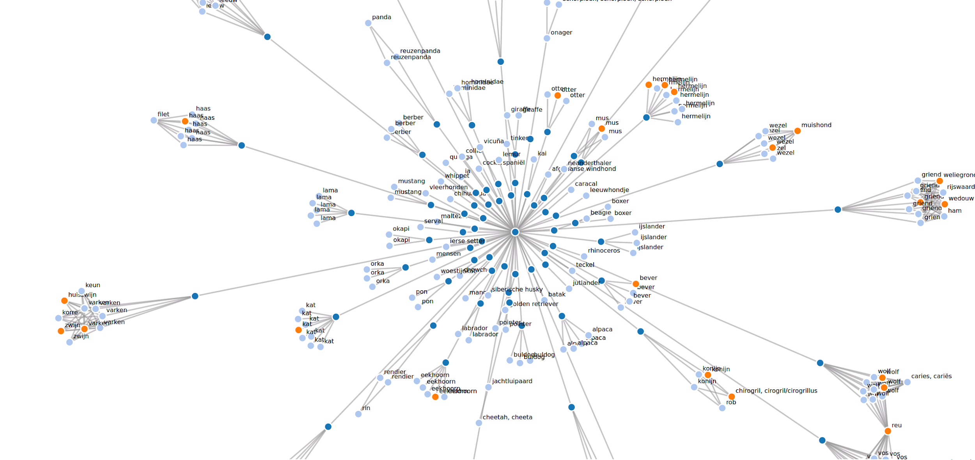
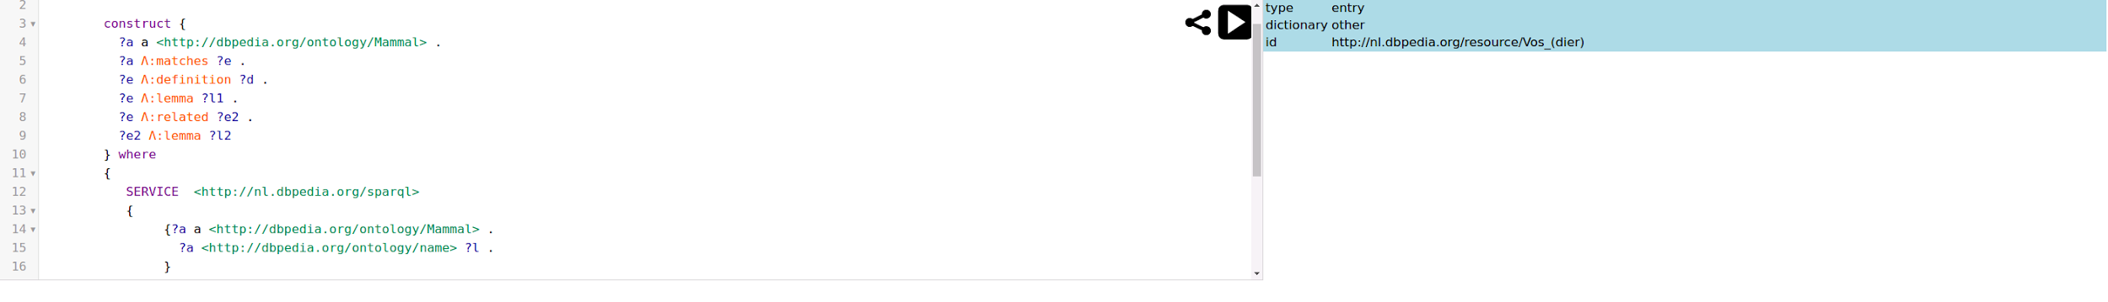
Next step: The lexicon as linked open data

Slide 15

Clariah search
(in WP3, linguistics) search corpora, treebanks, lexica
local search (ensure there are “endpoints”)
federated search (jointly query similar datasources)
chaining search (combine heterogeneous data sources)

Slide 16
Clariah search
(in WP3, linguistics) search corpora, treebanks, lexica
corpora (“token-based annotation”)
treebanks (syntactic annotation)
lexica
morphosyntactic
semantic
...

Slide 17
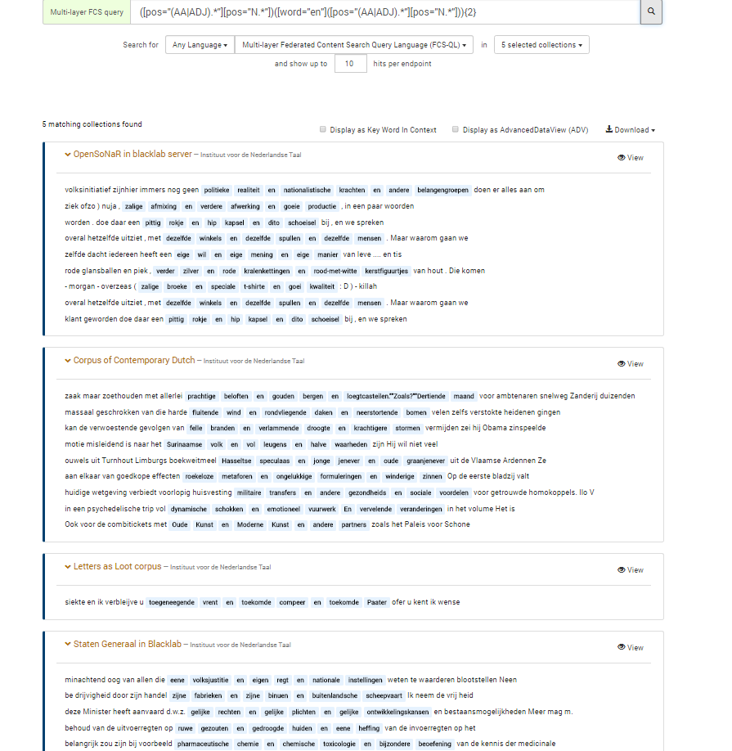
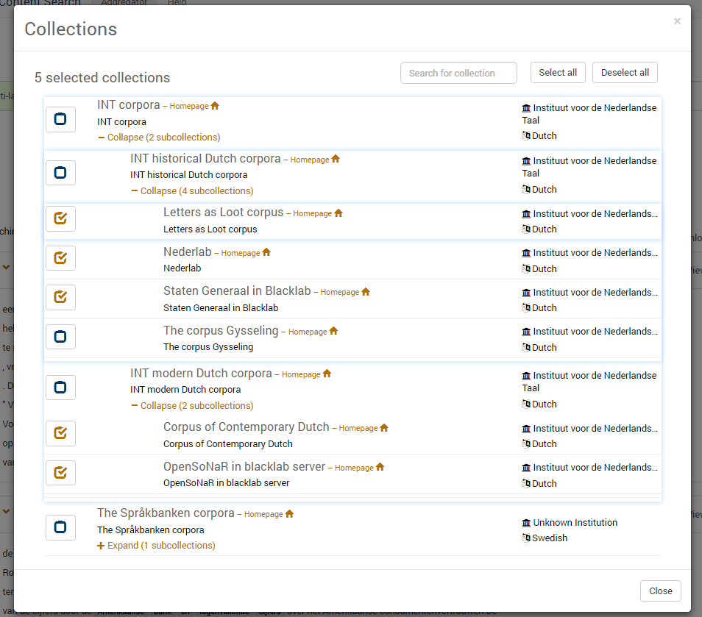
Clariah federated search
https://spraakbanken.gu.se/ws/fcs/2.0/aggregator/
Notes:
Some infrastructure for corpora federated search (historical and modern) is already available, and we intend to extend this for lexica.

Slide 18
Why linked open data??
Choice as main interoperability standard for CLARIAH
Interoperability without imposing a common schema on data
Simple but expressive data model
Aggregation and federation: easy transition
Compare with CLARIAH fcs 2.0 etc.
Although
Unsuitable for content management (at least, for now, for us)

Slide 19
Tower of babel problem
Each resource speaks its own language
query language
data encoding
linked open data and standard encoding schemas as interlingua / glue
universal dependencies

Slide 20
DiaMaNT/LOD use cases ...
Diachrony of similar terms
Combining semantic lexica
Using distributional information
“Join” with external ontology data
Deploy in corpus search
Notes:
We have the data in an rdf store (currently jena) and a simple application which allows us to test various retrieval scenarios.

Slide 21
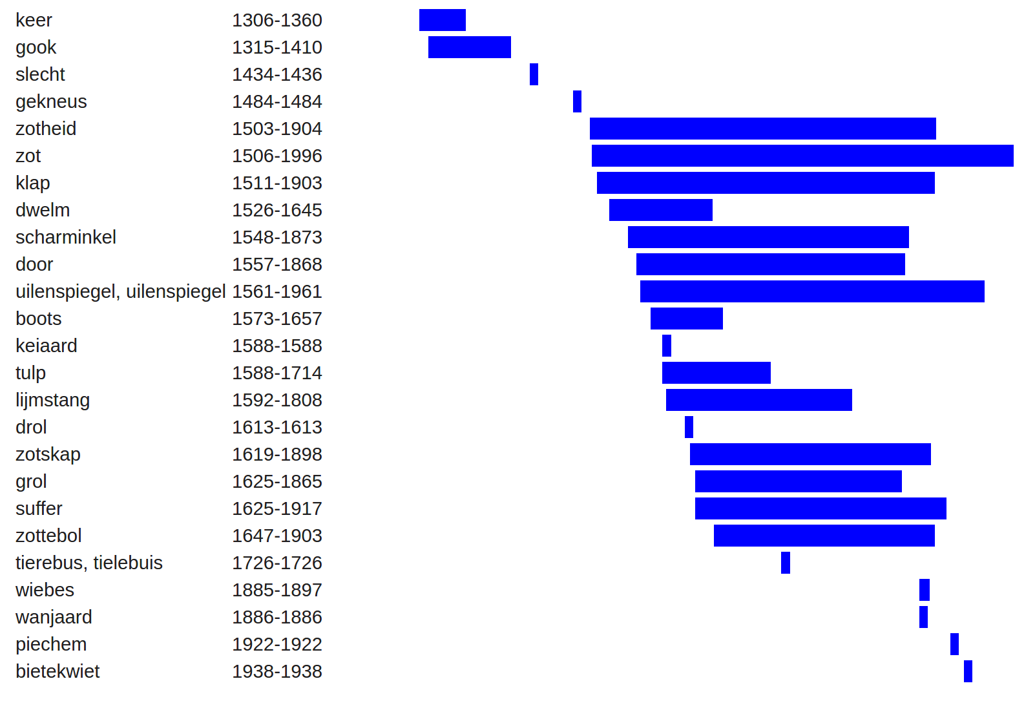
Attestation-based chronology of related terms

Slide 22
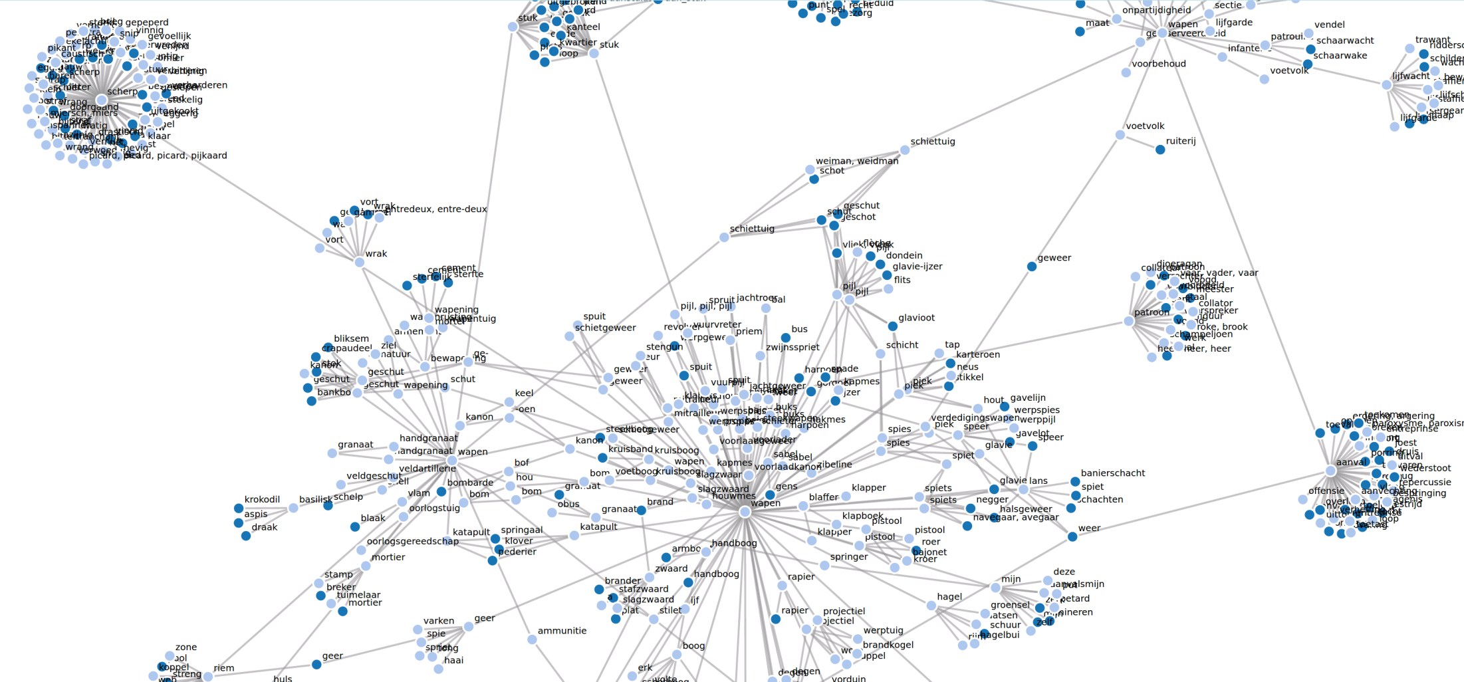
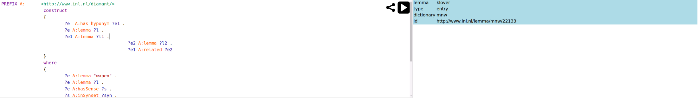
Combine with Open Dutch WordNet
Notes:
chaining search: open Dutch wordnet for weapon and the current diamant lexicon (VISUALISATION TOOLS NEEDED)
Dit was een combinatie van ODWN en diamant content
PREFIX diamant: <http://www.ivdnt.org/diamant#>
PREFIX lemon: <http://lemon-model.net/lemon#>
PREFIX lexinfo: <http://www.lexinfo.net/ontology/2.0/lexinfo#>
PREFIX rdfs: <http://www.w3.org/2000/01/rdf-schema#>
PREFIX rdf: <http://www.w3.org/1999/02/22-rdf-syntax-ns#>
PREFIX relation: <http://www.ivdnt.org/relation/>
construct
{
?e diamant:has_hyponym ?e1 .
?e diamant:lemma ?l .
?e1 diamant:lemma ?l1 .
?e2 diamant:lemma ?l2 .
?e1 diamant:related ?e2
}
where
{
?e lemon:canonicalForm ?f . ?f lemon:writtenRep ?l .
VALUES ?l { "wapen" }
?e lemon:sense ?s .
?s lemon:reference ?syn .
?syn relation:has_hyponym+ ?syn1 .
?s1 lemon:reference ?syn1 .
?e1 lemon:sense ?s1 .
?e1 lemon:canonicalForm ?f1 . ?f1 lemon:writtenRep ?l1 .
?s2 diamant:synonymDefinition ?l1 .
?e2 lemon:sense ?s2 .
?e2 lemon:canonicalForm ?f2 . ?f2 lemon:writtenRep ?l2
}

Slide 23
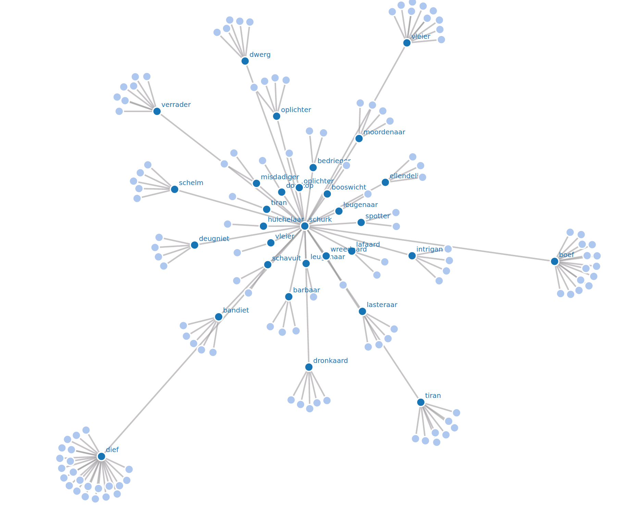
Notes:
You look for relations between dictionary data using distributional information from a diachronic corpus.

Slide 24
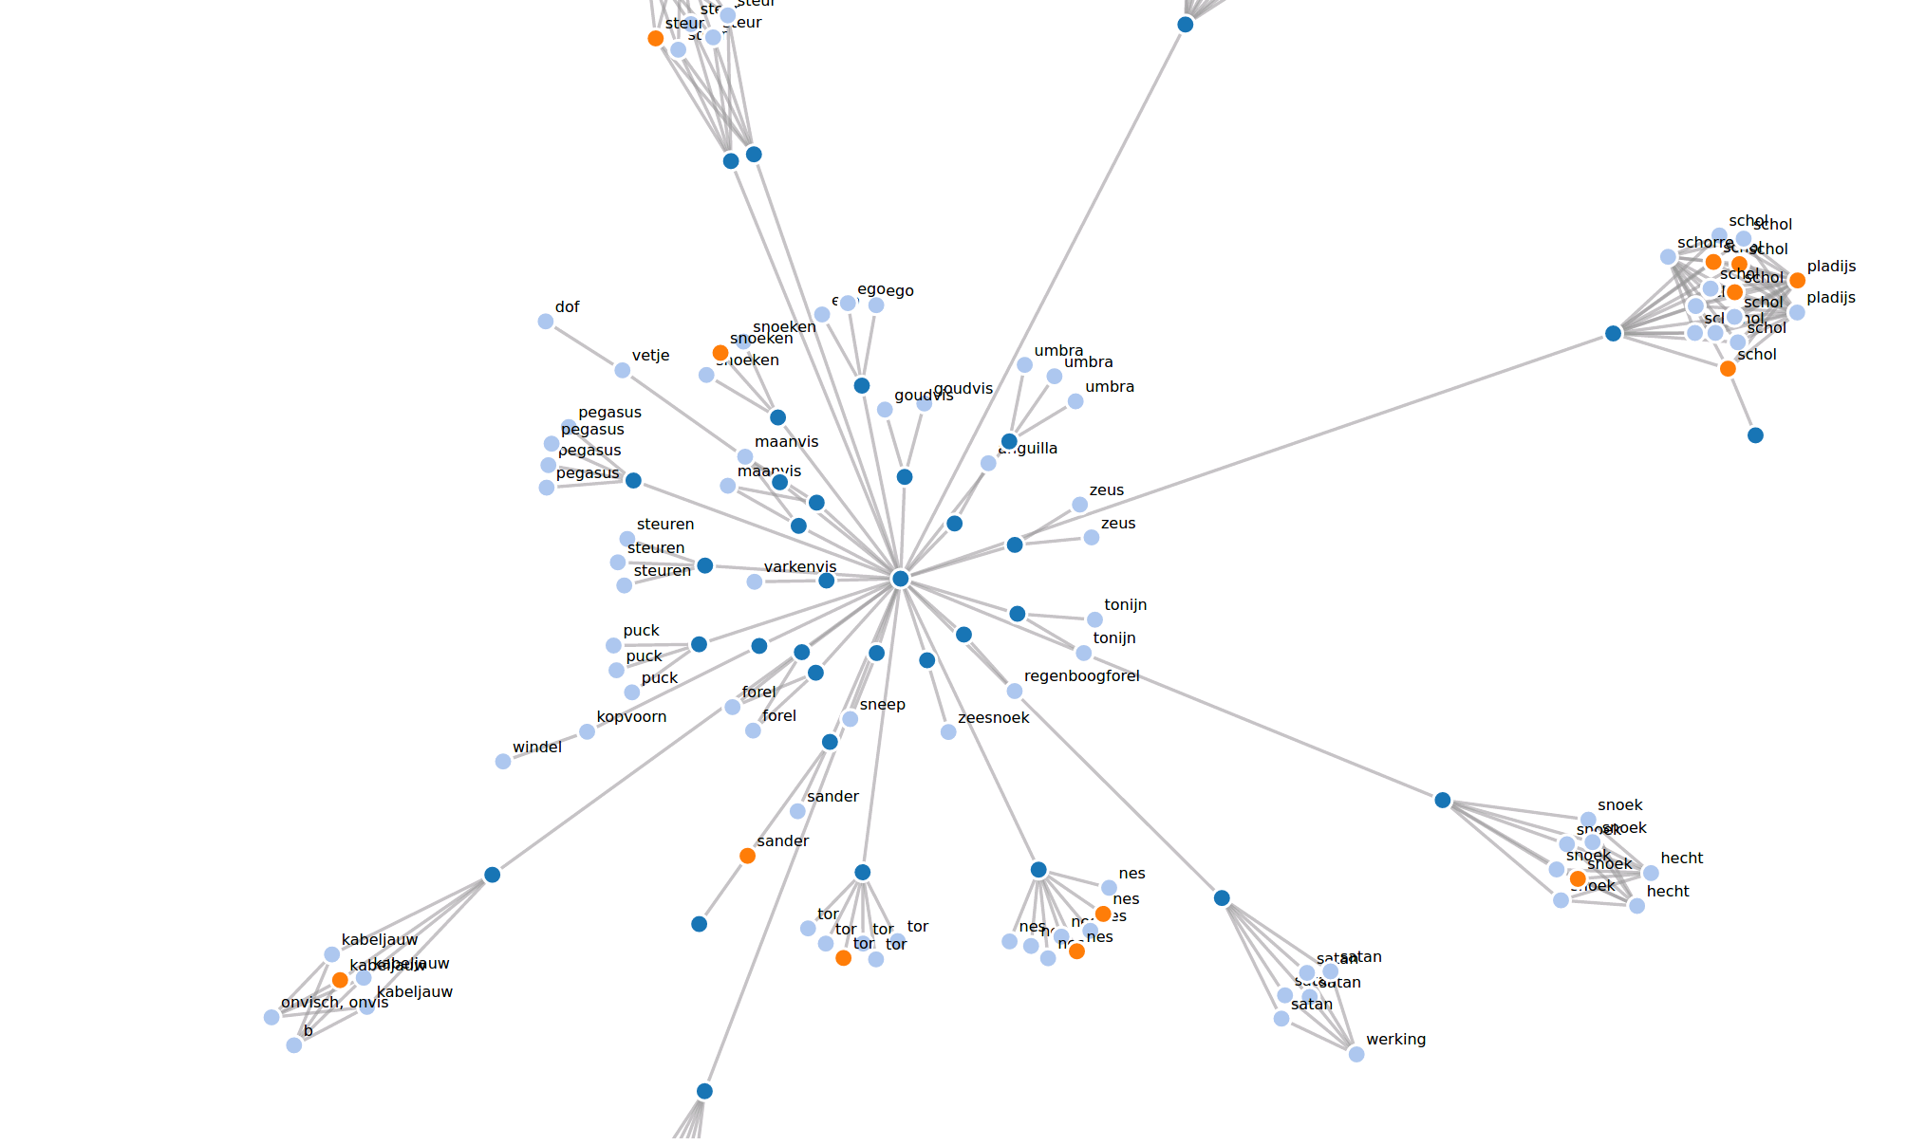
Link with DBpedia ontology
Notes:
Dit is de vissenquery:
PREFIX diamant: <http://www.ivdnt.org/diamant#>
PREFIX lemon: <http://lemon-model.net/lemon#>
PREFIX lexinfo: <http://www.lexinfo.net/ontology/2.0/lexinfo#>
PREFIX rdfs: <http://www.w3.org/2000/01/rdf-schema#>
PREFIX rdf: <http://www.w3.org/1999/02/22-rdf-syntax-ns#>
PREFIX xsd: <http://www.w3.org/2001/XMLSchema#>
construct {
?a a <http://dbpedia.org/ontology/Fish> .
?a diamant:matches ?e .
?e diamant:definition ?d .
?e diamant:lemma ?l1 .
?e diamant:related ?e2 .
?e2 diamant:lemma ?l2
} where
{
SERVICE <http://nl.dbpedia.org/sparql>
{
{
?a a <http://dbpedia.org/ontology/Fish> .
?a <http://purl.org/dc/terms/subject> ?s . ?s rdfs:label ?l
}
}
.
bind (lcase(xsd:string(?l)) as ?l1) .
?e lemon:canonicalForm ?f . ?f lemon:writtenRep ?l1 .
?e lemon:sense ?s1 .
?s1 lemon:definition ?def . ?def diamant:definitionText ?d .
OPTIONAL
{
?e2 lemon:sense ?s2 .
?s2 diamant:synonymDefinition ?l1 . ?e2 lemon:canonicalForm ?f2 . ?f2 lemon:writtenRep ?l2 .
# ?e2 diamant:pos "NOU"
} .
}

Slide 25
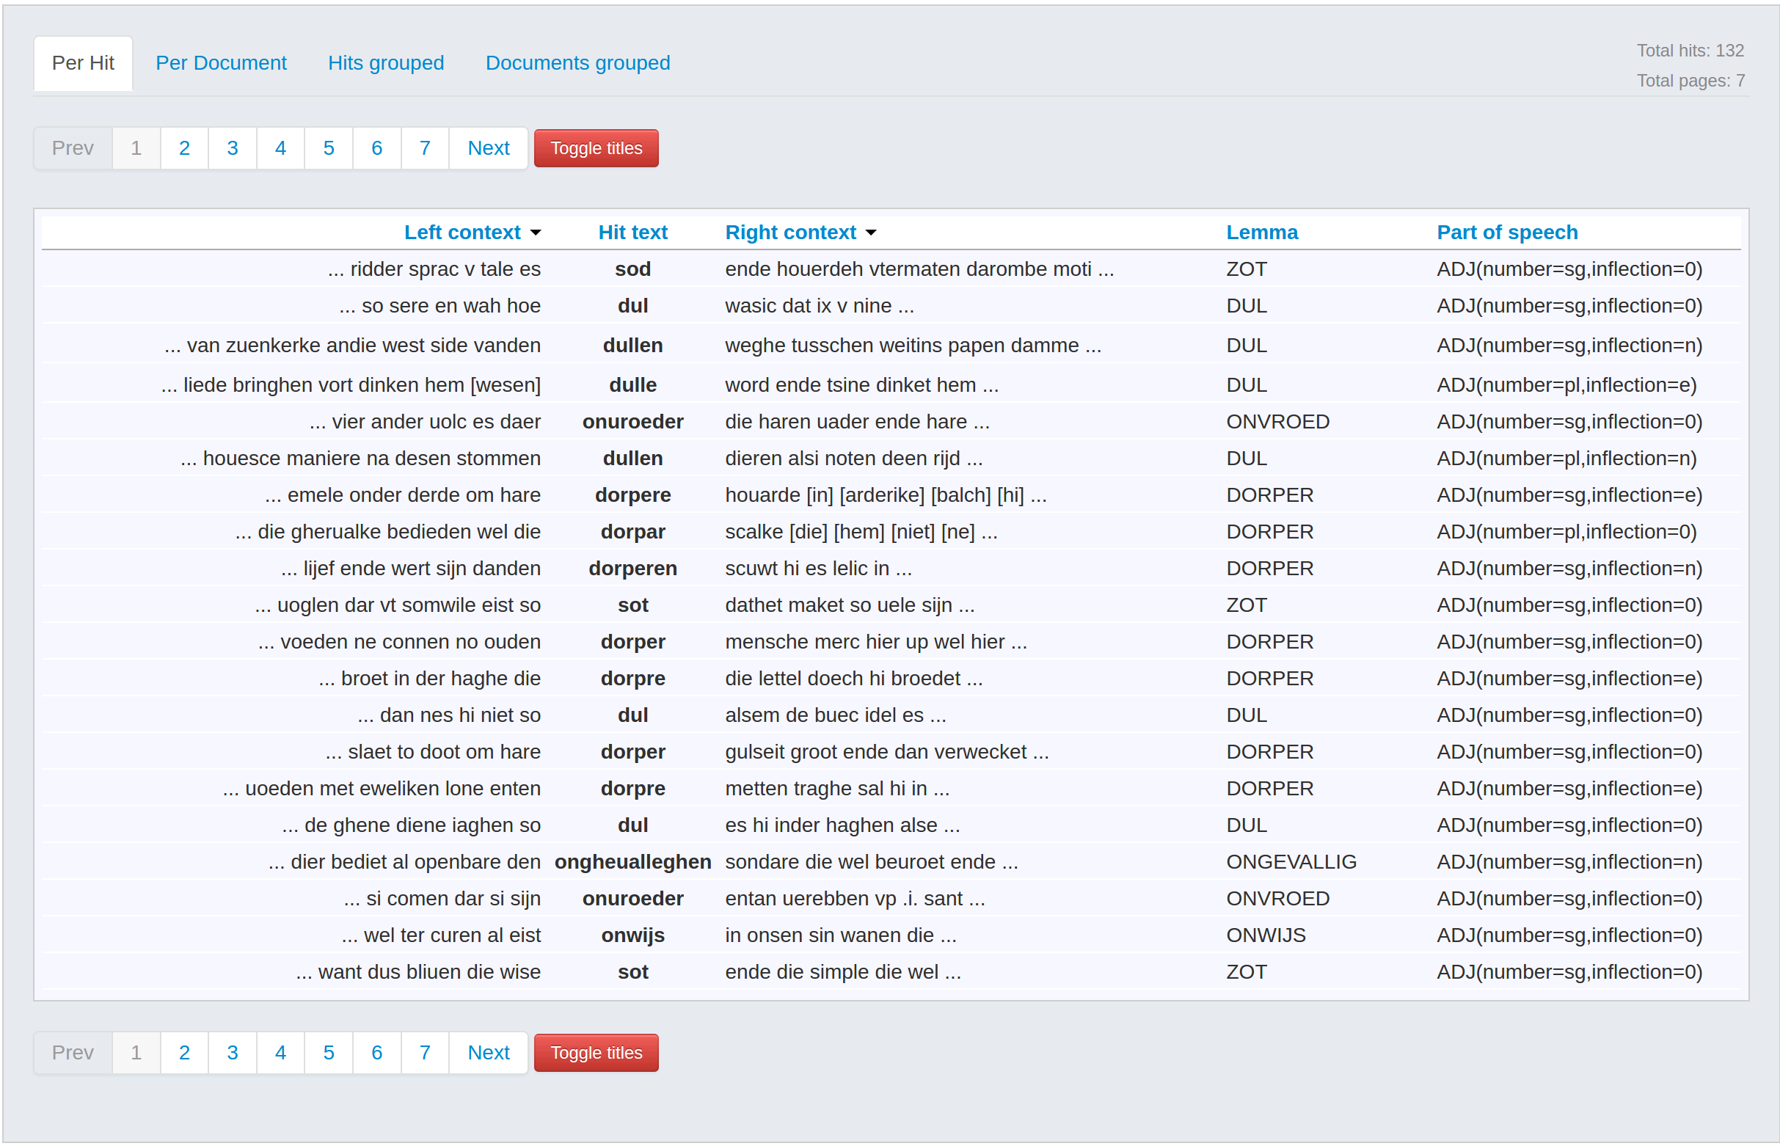
Use lexicon in corpus search
Notes:
simplest of applications

Slide 26
Federated vs aggregated
Each resource speaks its own language
convert or
map

Slide 27
Chaining search: corpora and lexica
SELECT distinct ?pw ?ow ?lvw ?lvl
WHERE {
SERVICE lassyklein:
{
?pred ud:nsubj ?onderwerp .
?pred ud:obj ?lv .
?onderwerp :word ?ow .
?pred :word ?pw .
?lv :word ?lvw
} .
graph <http://rdf.ivdnt.org/lexica/dbnl_similarity/>
{
?sim diamant:source "woede" . ?sim diamant:target ?lvl
} .
graph <http://rdf.ivdnt.org/lexica/diamant/v1.0/>
{
?e ontolex:canonicalForm ?lvc .
?lvc ontolex:writtenRep ?lvl .
?e ontolex:lexicalForm ?lvf .
?lvf ontolex:writtenRep ?lvw
}
}
Triples predicate, object, subject from corpus
Distributional similarity to target word
Word forms from lexicon

Slide 28
Chaining search: including treebanks
mapping
xquery
udPrefix + "nsubj" ->
BasicPattern(Set(
"object←$subject/../node[@rel='su']/node[@rel='hd' and @pos='noun']",
"subject←//node[@rel='hd' and @pos='verb' and parent::node[@cat='smain' or @cat='ssub']]",
), Set("subject", "object")),
sparql
prefix : <http://example.org/>
prefix ud: <http://universaldependencies.org/u/dep/>
select ?tonderwerp ?tgezegde ?tlv ?sent where
{
?gezegde ud:nsubj ?onderwerp .
?gezegde ud:obj ?lv .
?lv :precedes ?onderwerp .
?gezegde :text ?tgezegde .
?onderwerp :text ?tonderwerp .
?lv :text ?tlv .
?gezegde :sentence ?sent
}
for $gezegde in (//node[@rel='hd' and @pos='verb' and parent::node[@cat='smain' or @cat='ssub']]),
$lv in ($gezegde/../node[@rel='obj1']/node[@rel='hd' and @pos='noun']),
$onderwerp in ($lv/ancestor::node/descendant::node[xs:int(@begin) > xs:int($lv/@begin)]) intersect ($gezegde/../node[@rel='su']/node[@rel='hd' and @pos='noun']),
$tgezegde in (string-join($gezegde//@word, ' ')),
$tonderwerp in (string-join($onderwerp//@word, ' ')),
$sent in ($gezegde/ancestor::alpino_ds/sentence),
$tlv in (string-join($lv//@word, ' '))
return( <result><var><name>tlv</name><value>{$tlv}</value></var>
<var><name>tgezegde</name><value>{$tgezegde}</value></var>
<var><name>sent</name><value>{$sent}</value></var>
<var><name>tonderwerp</name><value>{$tonderwerp}</value></var></result>)

Slide 29
Discussion: future of tool use in humanities
what can we expect non-technical researchers to do
which tools are missing most
or need more work to be usable

